Slide 1
Appeals & Drafting under the Income Tax Act, 1961
A comprehensive Overview
08.10.2024 Janane Ganesan, Advocate
Abhinov Vaidyanathan, Advocate

Slide 2
Faceless Assessment
Introduced vide a scheme and incorporated in the IT Act as Section 144B of the IT Act w.e.f.01.04.2021
No physical interface between Assessees and Assessing Authorities.
Inclusions:
Assessment under Section 143(3) - original assessment
Assessment under Section 144 - best judgment assessment
Assessment and re-assessment under Section 147
Penalty proceedings for non-compliance of notice, direction or order passed under Faceless Assessment Scheme
Sections 271(1)(b) (till AY), 272A.
Exclusions:
Assessment under central charges eg: assessments consequent to search proceedings
Assessments in cases assigned to International Charges
Penalty proceedings except those covered under inclusions

Slide 3
Modalities of Assessment
Issuance of Notice under Section 143(2)
Check if the Notice has been issued within time – 3months from the end of the year in which return is furnished.
Limited scrutiny or complete scrutiny – Difference
Can a limited scrutiny be converted in a complete scrutiny? [ CIRCULAR F. NO. 225/402/2018/ITA.II, DATED 28-11-2018]
Reply to Notices under Section 142(1)
Detailed replies must be given for each of the queries raised.
Adjournments can be sought for in the IT Portal for a maximum of 15days. Specific reasons to be provided for seeking adjournment.
Reply to SCNs
Specific and detailed replies to be submitted in respect of each allegation raised by the Department.
Seek for personal hearing – There is a separate option in the Portal.

Slide 4
Modalities of Assessment
Reply to DAO
Specific and detailed replies to be submitted in respect of each allegation raised by the Department.
Seek for personal hearing
Once the personal hearing is over, seek for the transcript. Request is required to be made in the portal by way of a grievance.
Final Assessment will be passed u/s 143(3) r/w 144B
Check points to see from, the Final Order:
Submissions filed are considered properly
Submissions filed are considered and taken note of in the first place
Order is a speaking/well reasoned order.
Case laws relied upon are distinguished before rejecting its application

Slide 5
Hierarchy of Appeals
AO
30 days
CIT (A)
2 months from the end of the month
HC
120 days
SC
Monetary Limit [Circular No. 09/2024]
Before ITAT – 60 lakhs
Before HC – 2 Cr.
Before SC – 5 Cr.
ITAT
Notes:
ITAT Appeal – Section 253(3)
High Court Appeal – Section 260A
Supreme court appeal – Section 261 (appeal can be made to SC in any case which the HC certifies to be a fit one for appeal to the SC.

Slide 6
Exclusions to Monetary Limits
Where any provision of the Act or the Rules or notification issued thereunder has been held to be constitutionally invalid,
Where any order, notification, instruction or circular of the Board or the Government has been held to be illegal or ultra vires the Act or otherwise constitutionally invalid,
Where the assessment is based on information in respect of any offence alleged to have been committed under any other law received from any of the law enforcement or intelligence agencies such as CBI, ED, DRI, SFIO, NIA, NCB, DGGI, state law enforcement agencies such as State Police, State Vigilance Bureau, State Anti-Corruption Bureau, State Excise Department, State Sales/Commercial Taxes or GST Department,
Where the tax effect is not quantifiable or not involved, such as the case of registration of trusts or institutions under sections 10(23C), 12 A/ 12AA/12AB of the Act, order passed u/s 263 of the Act etc. The reference to cases involving sections referred here, where it is not possible to quantify tax effect or tax effect is not involved, is for the purpose of illustration only.
Where addition relates to undisclosed foreign income/undisclosed foreign assets (including financial assets)/undisclosed foreign bank account,

Slide 7
Appealable Orders before the CIT(A)
Intimation Order u/s. 143(1) or Regular Assessment order u/s 143(3)*
Under Best judgment Assessment u/s 144
Under Income escaping assessment u/s 147 or an an order of assessment or re-assessment in search cases
Assessment in case of search or requisition u/s 153(A)
Rectification order u/s 154
An order treating the assessee as the agent of NRI u/s 163
Assessment order after HUF partition
Order of grant of refund
Order made u/s 201 (incase assessee fails to Deduct TDS/ deposit within due dates)
Order made u/s 206C (incase assessee fails to Deduct TCS/ deposit within due dates)
Notes:
s. 246(1)(a) where the assessee objects to the amount of income assessed, or to the amount of tax determined, or to the amount of loss computed, or to the status under which he is assessed.
*except an order passed in pursuance of directions of the Dispute Resolution Panel

Slide 8
Doctrine of Merger – 143(1) and 143(3)
Case Study 1
Intimation under Section 143(1) passed wherein there is a variance w.r.t two issues. Assessee filed rectification under 154.
Assessee has not appealed against the said Intimation.
Assessment proceedings completed and assessment order passed comprising of same issues without any discussion.
Can the Assessee appeal against the Original Assessment Order for the issues pertaining to 143(1) as well?
Areca Trust v. CIT (Appeals) (ITAT Bangalore) [ITA No. 433/Bang/2023]

Slide 9
Doctrine of Merger – 143(1) and 143(3)
Case Study 2
Intimation under Section 143(1) passed wherein there is a variance w.r.t two issues.
Assessee forgot to appeal against the said Intimation.
Assessment proceedings completed and assessment order passed comprising of new issues not part of the Intimation under Section 143(1).
Can the Assessee appeal against the Original Assessment Order for the issues pertaining to 143(1) as well?
Global Entropolis (Vizag) Pvt Ltd v. AO [2023 (8) TMI 81 - ITAT Chennai]

Slide 10
Doctrine of Merger – 143(1) and 143(3)
Case Study 3
Intimation under Section 143(1) passed wherein there is a variance w.r.t two issues.
Assessee filed an application for rectification under Section 154 against the Intimation.
Application u/’s 154 has been rejected without providing proper reasoning.
At this stage, should an appeal be filed against the 143(1) Intimation or Order rejecting application u/s 154 or both?

Slide 11
Doctrine of Merger – 143(1) and 143(3)
Case Study 4
Intimation under Section 143(1) passed wherein there is a variance w.r.t two issues.
Assessee filed an appeal against the Intimation.
Original assessment proceedings completed for same issues and Order has been passed with proper discussion.
What will happen to the appeal filed against the Intimation?
The South India Club v. ITP [2024 (5) TMI 1125 - ITAT Delhi]

Slide 12
Doctrine of Merger – 143(3) and 147
Case Study 5
Assessment Order has been passed for 2 issues.
Re-assessment Order has been passed for 5 issues which includes the 2 issues dealt in the Assessment Order.
Whether Doctrine of Merger apply?

Slide 13
Doctrine of Merger – 143(3) and 154
Case Study 6
Assessment Order has been passed where addition of Rs. 1,00,000 has been made.
Assessee files an application under Section 154 for rectification
Rectification application accepted.
Rectification application rejected stating that there is no mistake apparent on record.
Order under Section 154 wherein the addition is enhanced to Rs. 2,00,000.
Whether doctrine of merger will be applicable in the present case?
Kothari Industrial Corporation Ltd. Vs. Agricultural Income Tax Officer – (1998) 230 ITR 306 (Kar)
Appeals for the above scenarios?

Slide 14
Form of Appeal – S. 249
Form of Appeal
Rule 45
Manner
Appeal shall be made to CIT (A) on or after 01.10.1998
Fee as per total income computed by AO
Less than 1,00,000 – Rs. 250
1,00,001 – 2,00,000 – Rs. 500
More than 2,00,001 – Rs. 1000
Subject matter not covered above – Rs. 250
JCIT (A) on or after 01.04.2023
Irrespective of date of initiation of assessment proceeding
Form No. 35
Verification – person authorized to verify RoI – S. 140
Furnish RoI electronically – Rule 12(3): digital signature or electronic verification code.
If appeal relates to Orders under 201, the same need to be filed in the TAN IT Portal of the Assessee.
Notes:
Section 140 – return shall be verified by individual himself, company means MD or director.
Rule 12(3) – conditions to furnish electronically

Slide 15
Presentation of Appeal, Limitation
Presentation of Appeal
Presented within 30 days
30 days time limit to be construed from
If appeal is with respect to denial of TDS, then from date of payment of tax
If appeal with respect to assessment or penalty, date of service of notice of demand
Unlimited Powers to condone
JCIT (A) or CIT (A) may admit appeal after expiration of 30 days if there is sufficient cause.

Slide 16
How to draft a Condonation of Delay Application
A Condonation of Delay Application must be made if there is a delay beyond 30 days.
The Application must be accompanied by an affidavit elucidating reasons for delay.
While adjudicating on the CoD Application, the CIT (A) must determine on whether there is ‘sufficient cause’.
If say, there was a delay on account of employee handling tax matters suffering from medical illness, then an affidavit must be annexed and a medical certificate must be enclosed, to that effect.
What is the next course of remedy if the CoD is rejected by the CIT(A)?

Slide 17
Condonation of Delay
Term ‘Sufficient Cause’
Sufficient cause means a cause which is beyond the control of the party invoking the aid of provisions of law and any cause that prevents a person approaching the court within time.
Sufficient cause must be liberally interpreted so as to advance substantial justice.
Judicial decisions in support-
Premalatha Pagaria v.s ITO (2021) 130 taxmann.com 403
Hindalco Industries Ltd v. UoI (2024) 158 taxmann.com 485 (Bombay)
Kvaerner Boving Construction Ltd v. DCIT (1996) 54 TTJ 429 (Del)

Slide 18
Condonation of Delay
Factors to be taken into account for establishing ‘Sufficient Cause’
Exercise of power to condone delay is discretionary. The power may not be exercised for factors like inordinate delay, negligence and want of due diligence.
Merely because some persons have obtained relief vide condonation, does not mean others are entitled.
Merits are not required to be considered.
Judicial decisions in support-
Pathupati Subba Reddy v. Special Deputy Collector (2024) 4 S.C.R 241
Sri Ram Mandir Katargam v. CIT (2024) 164 taxmann.com 265 (Surat- Trib)

Slide 19
Practical Scenarios – Condonation of Delay
Few common grounds where CoD is allowed
Time taken in pursuing other remedies may be a valid cause - CIT v K.S.P Shanmugavel Nadar & Others (1985) 153 ITR 596 (Mad) – Not to indulge in forum shopping
A subsequent decision of the Supreme Court or a High Court resulting in change of legal position – CIT v Sothia Mining & Mfg. Corp.(1990) 186 ITR 182 (Cal)
Non – service of Assessment Order to the registered mail ID of the Assessee.
Kothandaraman Praesh v. ACIT (2023) 154 taxmann.com 425 (Madras)
Adaikathal Nallathankgal Padaippu Veedu v. Income Tax Officer (2024) 159 taxmann.com 465 (Chennai – Trib)
Non – availability of legal counsels / acted on basis of advice by legal counsels
Meenachil Taluk Cooperative Employees Cooperative Society v. CIT (2024) 165 taxmann.com 366 (Kerala)
Mahaveer Prasad Jain v. PCIT (2023) 153 taxmann.com 207 (Jaipur – Trib)

Slide 20
How to draft an appeal before CIT (A) – Form 35
Step 1
Login to the income tax portal ‘eportal.incometax.gov.in’ – PAN or TAN
Then select Form No, 35 (Appeal before CIT (A))
Step 2
Once Form No. 35 / file appeal is opted for, a tab opens with the options ‘Back’ or ‘Lets get started’.
Step 3
Once the aforesaid details are filled, a tab (as contained in the next page) is visible. Details with respect to the same are required to be filled.
Once the same have been filled, the next step is to ‘Preview the form’ and then verify the same. The same can be done either by opting for DSC, Electronic Verification Code or Aadhar linked mobile generated OTP.
Under the tab ‘e-File’ opt for file income tax forms.
Alternatively, under the tab e-proceedings, can opt for the relevant AY and then against the relevant order, opt for ‘File Appeal’.
The option ‘Lets get started’ will direct to a page with details as to date of the Order – in – challenge, Date of service of Order, Applicable Order type etc.

Slide 21
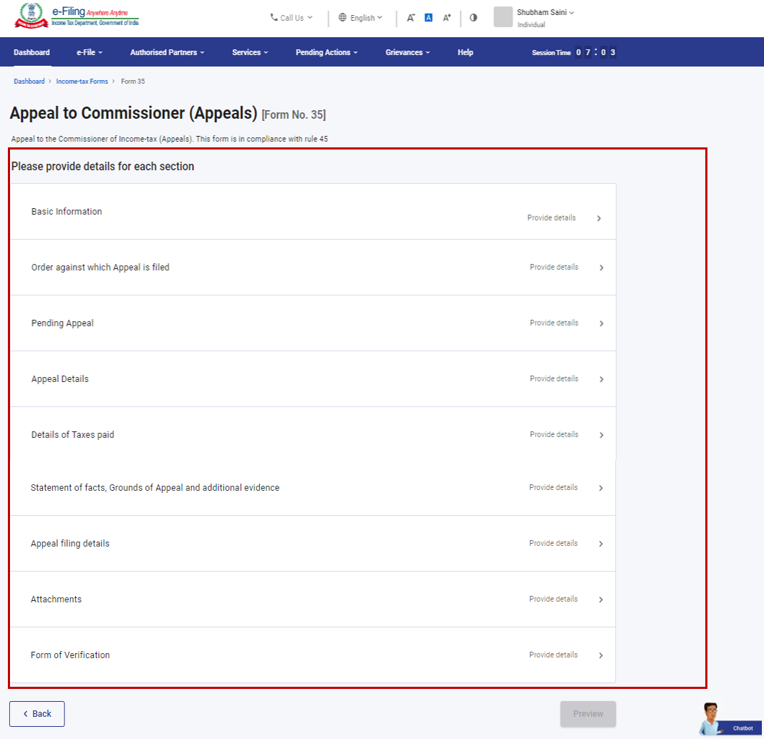
How to draft an appeal before CIT (A)

Slide 22
Important Requisites – Appeal Related filing
The Appellant is required to file detailed facts at the time of filing the appeal.
At the time of filing an appeal, grounds of appeal required to be listed.
The grounds of appeal must be comprehensive and give a prima facie view on the case in hand.
The detailed facts and grounds are required to be listed under ‘ Statement of facts, Grounds of Appeal and additional evidence’.
The detailed facts and grounds may be printed on the letterhead of the company and the same may be annexed under the tab ‘attachments’.
Any documentary evidence in support of the appeal is required to annexed under the tab ‘Attachments’.
Written submissions may be uploaded at the time of issuance of hearing notice u/s 250 of the IT Act.
It is advisable that a stay application be filed before the Jurisdictional AO.

Slide 23
Filing of stay application against recovery of demand
Once an appeal is filed before the NFAC/CIT(A), a stay application before the Jurisdictional Assessing Officer must be filed.
This application must within 30days from the date of the demand notice once the appeal is filed.
CBDT Instruction dated 31.07.2017 – Stay of demand on payment of 20% of the disputed amount by the Assessee.
Exclusions:
Addition relates to issues decided against the Assessee in PYs, a lumpsum amount more than 15% may be demanded.
Addition relates to issues decided in favour of the Assessee in PYs, a lumpsum amount less than 15% may be demanded.

Slide 24
Filing of stay application against recovery of demand
Assessee can seek for a full stay of demand.
Essential aspects to be covered in the application:
Prima facie case
Financial difficulty/stringency – irreparable injury and undue hardship
Balance of convenience
Case on merits – Very brief
Attach Form 35
Stay application to be disposed within 2 weeks by AO.
If aggrieved by the Order of the AO in disposing the application, review can be preferred before Pr.CIT/ CIT, Review must be disposed within 2 weeks.
If aggrieved by the Pr.CIT/CIT Order – Writ before HC

Slide 25
Filing of stay application against recovery of demand
AO is required to pass a speaking Order and trinity principle is to be followed – Kannammal vs. ITO (2019) 103 taxmann.com 364 (Madras High Court).
Even if the stay application of the Assessee is bereft of details, Memorandum of appeal must be taken into account by the AO – blanket direction of 20% not tenable – Queen Agencies vs. ACIT (2021) 128 taxmann.com 107 (Madras)

Slide 26
Production of Additional Evidence
Rule 46A (Appellant cannot submit additional evidence except for-
Where the AO has refused to admit evidence which ought to have been admitted
Where the appellant was prevented by sufficient cause from producing evidence which he was called upon to produce by AO
Where the appellant was prevented by sufficient cause from producing before the AO any evidence which is relevant to any ground of appeal
AO passed Order without giving sufficient opportunity of adduce evidence relevant to appeal

Slide 27
Rule 46A – Additional Evidence
Non admission of evidence
Evidence cannot be admitted unless CIT (A) records reasons in writing in support of admission
Reasonable opportunity
CIT (A) shall have the power to direct production of any document required to dispose the appeal or for any substantial cause including enhancement of assessment or penalty.
Powers to direct production
Prior to admitting the evidence, AO must be provided with reasonable opportunity to examine the evidence, produce any evidence in rebuttal of the additional evidence.

Slide 28
Practical Scenarios – Additional Evidence
Additional evidence may be admitted if such evidence is needed to go to the ‘root of the issue’
DCIT v. Rankin Infrastructure Pvt Ltd (2022) 142 taxmann.com 37 (Mumbai – Trib)
FR. Sauter AG v. Income Tax Officer (2024) 158 taxmann.com 161 (Delhi – Trib).
PCIT v. Daljit Singh Sra (2017) 80 taxmann.com 271 (Punjab and Haryana)
CIT (A) must record reasons for admission in writing.
CIT v. Alcon Resort Holding Ltd (2023) 151 taxmann.com 98 (Bombay)
CIT v. Ranjit Kumar Choudhury (2007) 162 taxman 257 (Gujarat)
CIT (A) must take into account, objections raised by AO before admitting additional evidence
CIT (A) v. Sangu Chakra Hotels Pvt Ltd (2016) 74 taxmann.com 76 (Madras)
ACIT v. Kandoi Transport Ltd (2020) 120 taxmann.com 92 (Cuttack – Trib)
Enzen global Solutions Pvt Ltd v. ITO (2022) 144 taxmann.com 2 (Bangalore – Trib)

Slide 29
Procedure after filing an Appeal before CIT(A)
Furnish Vakalathnama or Power of attorney to plead the case on behalf of assessee before the CIT(A) and affix a court fee stamp value as applicable.
An application to pray for stay of the penalty proceedings till disposal of the case to be presented before the Jurisdictional Assessing Officer.
An application to pray for stay of demand till disposal of case to be made before the Jurisdictional Assessing Officer.
Order will be passed by the CIT(A) after having heard both parties

Slide 30
Powers of CIT(A)/NFAC
CIT(A)/NFAC has wide powers
CIT(A)/NFAC can examine any issue. It need not be restricted to the issues for which appeal was preferred.
CIT(A)/NFAC can confirm, enhance, reduce or annul the assessment.

Slide 31
Appeals & Drafting before ITAT

Slide 32
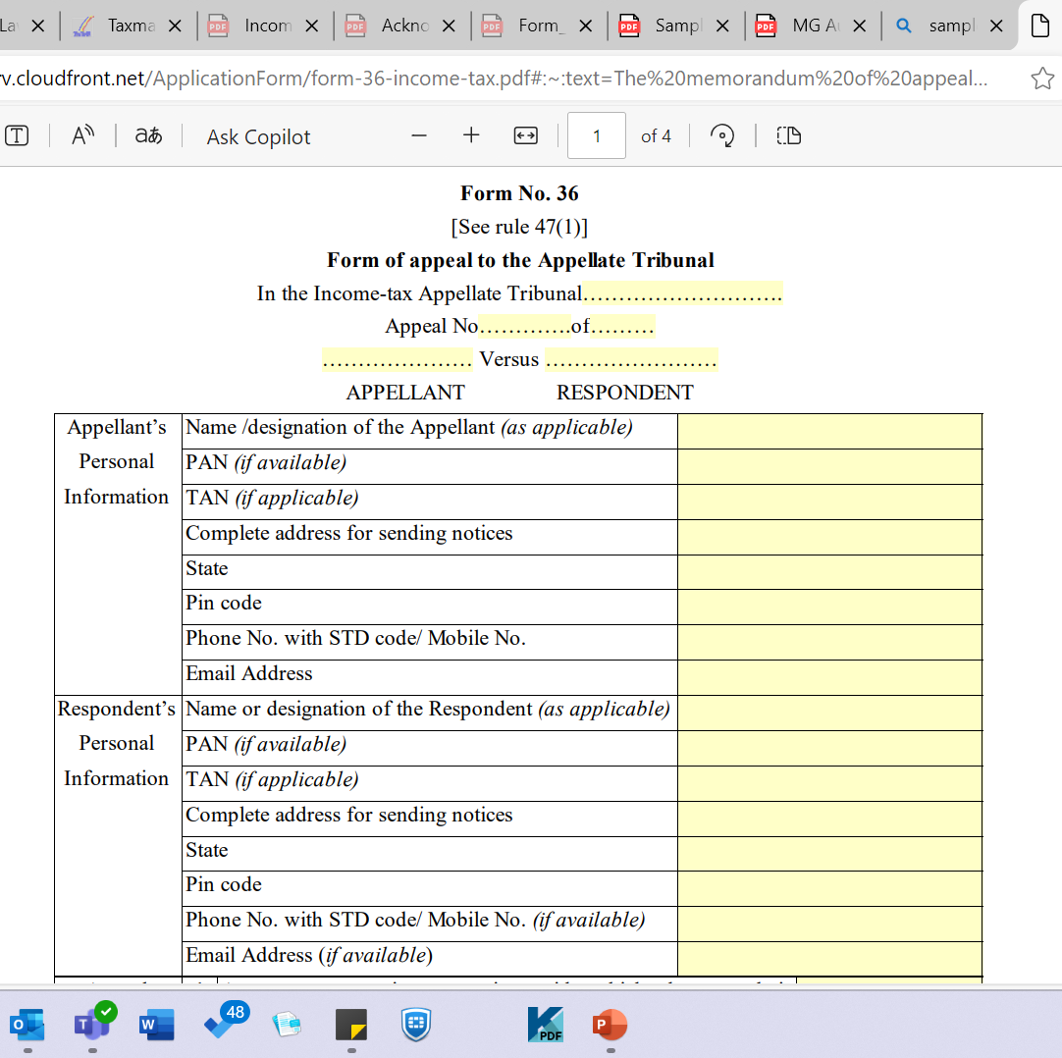
Filing of Form No. 36
Respective details to be entered.
Respondent should be the Jurisdictional Assessing Officer not NFAC / National faceless assessment centre.

Slide 33
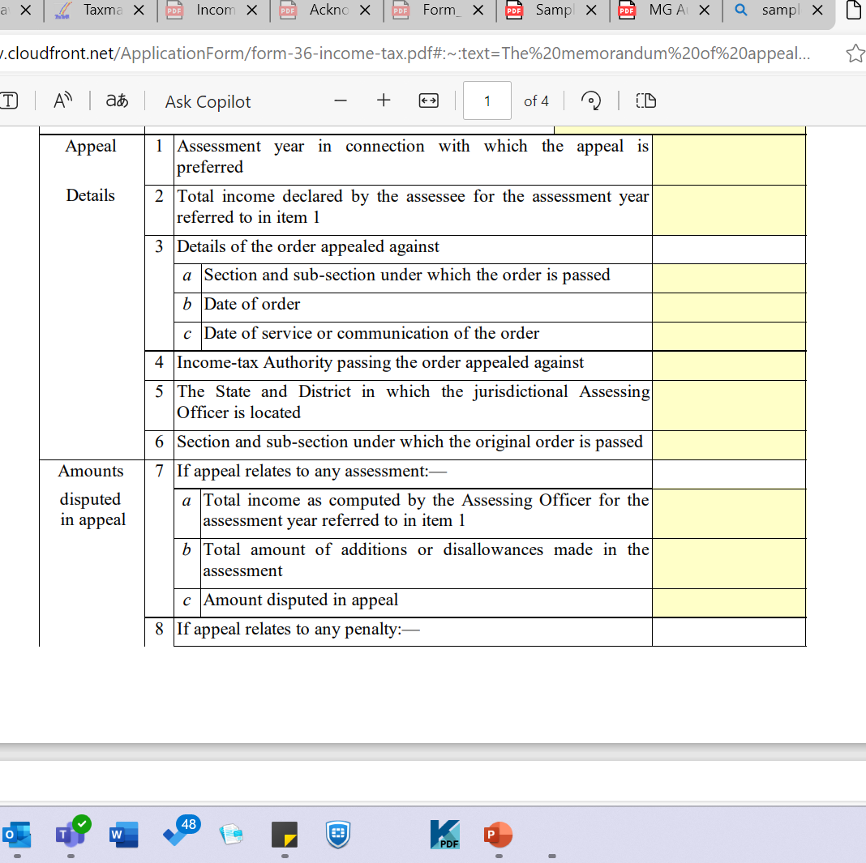
Filing of Form No. 36
Respective amounts to be entered.
Reference may be taken from Assessment Order / Giving effect order (CIT (A))

Slide 34
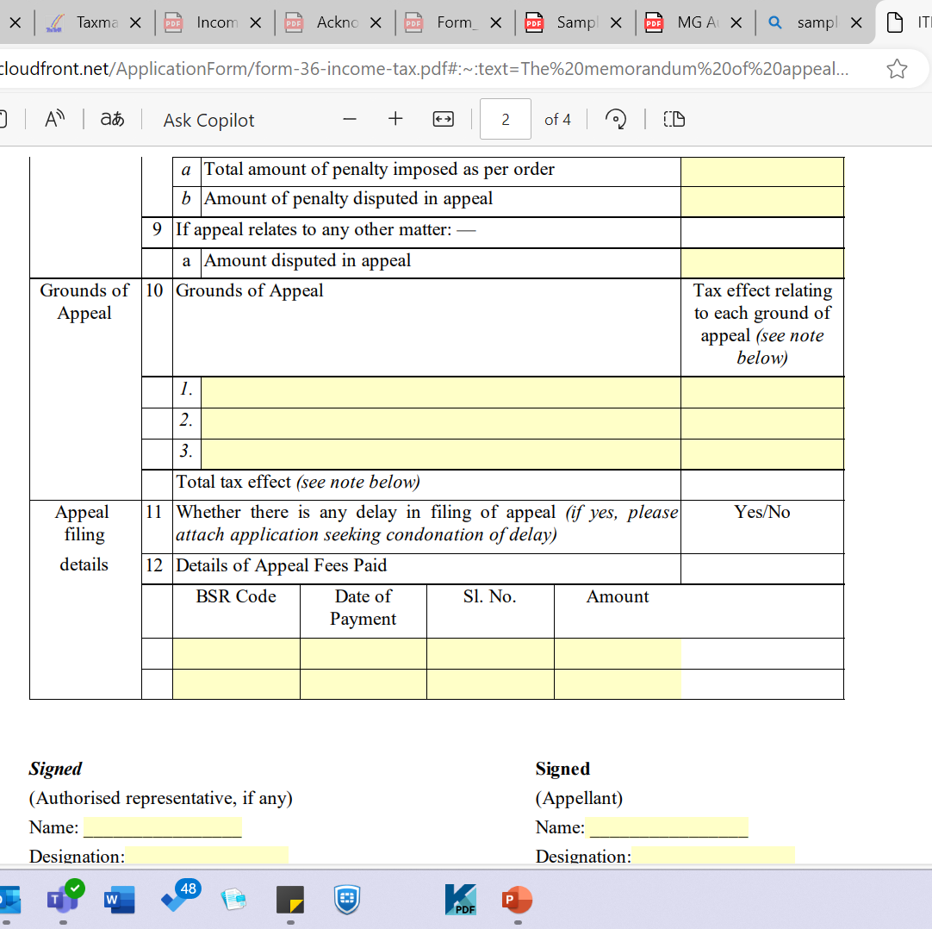
Filing of Form No. 36
Grounds of Appeal
Grounds of Appeal - separate sheet or part of the highlight.
Leave to add / modify / alter / delete grounds - Important
Tax effect shall be computed as-
tax component (due to the additions made) plus surcharge and cess
If delay in filing - CoD
Appeal fees payment evidence

Slide 35
Orders that are appealable – S. 253(1)
Order passed by DCIT / CIT (A) u/s 154, 158BFA, 250, 270A, 271, 271A, 271AAB, 271AAC, 271AAD, 271J, 272A
Order passed by JCIT (A) u/s 154, 250, 270A, 271, 271A, 271AAC, 271AAD, 271J
Order passed by AO u/s 158BC(c), search u/s 132, 132A (after 30.06.1995 but before 01.01.1997), S. 115VZC
Order passed by PCIT / CIT u/s 12AA, 12AB, 80G (5)(vi), 263, 270A, 271, 272A, 154 amending any such Order
Order passed by AO u/s 143(3) , 147, 153A, 153C in pursuance to directions of DRP or 154 in respect of such Order
Order passed by AO u/s 143(3), 147, 153A, 153C with the approval of PCIT / CIT as referred to in S. 144BA(12) or 154, 155 in respect of such Order.
Order passed by prescribed authority u/s 10(23C)(iv), (v), (vi) , (via)

Slide 36
Time limit for filing appeal – S. 253(3)
Prior Position
Amendment (w.e.f 01.10.2024)
60 days from date on which Order sought to be appealed against is communicated to the Assessee.
Two months from the end of the month in which Order sought to be appealed against is communicated to the Assessee to PCIT or CIT.

Slide 37
Fees and Manner of Payment
Fees
Fees based on total income computed by AO
Manner of Payment
Login to income tax e-portal
If less than 1,00,000 – Rs. 500
Enter AY and under ‘Type of Payment (minor head’, press ‘Other receipts’. Then ‘Appeal fees’.
Under e-file tab, opt for e-pay tax.
Under the head ‘New Payment’, opt for ‘Proceed’ under Corporation tax / individual tax.
On the next page, entire amount of fees payable in the ‘Other’ Column.
From 1,00,001 to 2,00,000 – Rs. 1500
More than 2,00,001 – Rs. 10,000
Subject matter not covered above – Rs. 500

Slide 38
Pointers – Grounds of Appeal, Submissions
Grounds of Appeal
A brief summary of the issues, the holding of the CIT (A).
Detailed written submissions
Detailed written submissions encompass the arguments presented in court. Preferred to file after the closing of arguments.
In essence, compilation of issues.
Word choice: ‘erred in holding’, ‘ought to have considered’, ‘ought to have taken into account’
Contents of submissions
Background of case (including issuance of notices under various stages, limited v. complete scrutiny)
Relevant facts with respect to the issues in hand
Grounds of Appeal must be elucidated. Each ground must be accompanied by relevant sections, judicial decisions.
Any relevant documentary evidences can be accompanied by placing them as annexures.

Slide 39
How to draft a Condonation of Delay Application
A Condonation of Delay Application must be made if there is a delay beyond 2 months from the end of the month in which Order appealed against is communicated.
An Application can be made before Hon’ble ITAT at the time of filing appeal, executed on a RS. 100 stamp paper – reasons for delay (affidavit).
While adjudicating on the CoD Application, the Hon’ble ITAT must determine on whether the reasons are sufficient explaining the delay.
If say, there was a delay on account of employee handling tax matters suffering from medical illness, then an affidavit must be annexed and a medical certificate must be enclosed, to that effect.

Slide 40
Powers of ITAT – S. 255(6)
Powers vested in ITO u/s 131
Same powers as vested in a court under CPC, 1908.
Deemed to be a civil court
ITAT shall be deemed to be a civil court for Section 195 of IT Act and Chapter 35 of CrPC, 1898.
Deemed to be judicial proceeding
Inquiry / investigation u/s 90 / 90A.
Impound and retain in its custody any books of accounts or other documents produced before it.
Any proceeding before the ITAT shall be deemed to be a judicial proceeding as per Sections 193, 228 and 196 of IPC
193 – Punishment of imprisonment for false evidence.
228 – Punishment of imprisonment / fine for intentional insult or interruption to public servant sitting in judicial proceeding.
Chapter 35 of CrPC – Irregular Proceedings
Notes:
Powers as vested in a court under CPC, when trying a suit in respect of the following matters-
Discovery and inspection
Enforcing attendance of any person, including any officer of a banking company and examining him on oath
Compelling production of books of accounts and other documents and
Issuing commissions

Slide 41
Orders of ITAT – S. 254
Pass orders after providing opportunity of being heard.
Rectification of mistake
Within 6 months from the end of month in which Order is passed, amend Order with a view to rectify any mistake apparent on record.
No amendment with effect to enhance assessment / reduce refund can be made unless notice is provided to Assessee
Application accompanied by fee of Rs. 500.
Appeal may be heard and decided within 4 years from end of FY in which appeal was filed.
After consideration of merits, stay may be granted within 180 days subject to payment of not less than 20%.
Stay application may be filed, accompanied by a fee of Rs. 500.

Slide 42
E-filing - Portal
Who are you? Assessee / Department
E-Mail ID, PAN / TAN, mobile number – OTP Verification
State and District of AO (for identification of ITAT Bench)
Select Appeal, Cross Objection, Stay Application, Miscellaneous Application*
Form No. 36 available to be filled online.
Once all data is filled, a Memorandum of Appeal shall be automatically generated. The same must be signed and uploaded.
All enclosures must be uploaded. (Mandatory and Optional)
Once e-filing is completed, acknowledgment is generated
The same must be downloaded and filed physically before respective bench.
Note: date of filing physically is reckoned as date for computation of limitation
Notes:
Memorandum of Cross Objection only be filed against appeal pending before ITAT
Stay Application can only be filed against Appeal pending
Only assessee can file stay application
MA can only be filed against an appeal disposed off by Tribunal.
ITAT e-Filing Login.

Slide 43
Memorandum of Cross Objections
S. 253(4) and S. 253(5)
AO / Assessee (as case may be), on receipt of notice that appeal has been filed by other party may within 30 days file memorandum of cross objections. After 30 days, cross objections may be filed, if ITAT is satisfied on ‘sufficient cause’.
Rule 47(2)
Shall be made as per Form 36A.
If made by Assessee, then verification shall be as per Rule 45(3).
Form 36A
Similar to Form No. 36 (Appeal Number to be added)

Slide 44
Filing of Paperbook
Index of Documents
Paperbook containing relevant documents may be filed.
Case law compilation
Relevant case laws and relevant provisions may be filed as a separate compilation or as a part of the aforementioned compilation.
Any documentary evidences like proof of tax deduction, extracts of annual reports may be filed as a compilation.
The said Paperbook must be accompanied by a certification ‘All documents have been filed before the lower authorities’.
The same may be given during the course of the hearing or filed prior to the arguments.

Slide 45
Production of Additional evidence
Rule 29 of the Income Tax (Appellate Tribunal) Rules, 1963
Parties shall not be entitled to produce additional evidence either oral or documentary before the Tribunal.
If the Tribunal requires any document to be produced or any witness to be examined or
Any witness to be examined or any affidavit to be filed to enable it to pass orders or
For any substantial cause or
If the Income tax authorities have decided the case without giving any sufficient opportunity to Assessee,
The Tribunal, for reasons recorded, may allow such document to be produced or witness to be examined or affidavit to be filed or may allow such evidence to be adduced.

Slide 46
Production of Additional evidence – Judicial Decisions
Circumstances pertaining to admission of additional evidence
CIT v. Ku. Pa. Krishnan (2012) 345 ITR 38 (Madras)
Once a document is admitted as additional evidence, there are two options- either Tribunal may consider the document and decide the case on its own or remit the matter back to the AO. Rule 29 – mandates the Tribunal to satisfy itself as to whether the documents can be entertained. If so, shall apply its mind to the veracity of documents.
Carburettors Ltd v. ACIT (2016) 69 taxmann.com 384 (Madras)
Powers of ITAT can be exercised only in situations where evidence could not be produced before lower authorities
Mahavir Prasad Gupta v. JCIT (2006) 5 SOT 353 (Delhi – ITAT) - Exception
Shivangi Steel (P) Ltd v. ACIT (2014) 42 taxmann.com 393 (Agra – Trib)
Kanniappan Murugadoss v. ITO (2017) 79 taxmann.com 244 (Chennai – Trib)
Braganza Construction (P) Ltd v. ACIT (2020) 116 taxmann.com 11 (Bombay)

Slide 47
Production of Additional evidence – Judicial Decisions
Application under Rule 29 must be considered by Tribunal before passing Order
HL Malhotra & Co (P) Ltd v. DCIT (2021) 125 taxmann.com 70 (Delhi)
If evidences are material to adjudication, ITAT may remand the matter to lower authorities for adjudication
Block Resources Coordinator Rajiv Gandhi Siksha Mission v. ITO (2023) 155 taxmann.com 649 (Raipur- Trib)
Moonlight Properties (P) Ltd v. ACIT, Central (2024) 161 taxmann.com 456 (Chandigarh – Tribunal)

Slide 48
Can a new ground be raised?
New ground may be raised before ITAT, provided a petition is filed requesting for the same.
The Petition must be signed by the Assessee (not authorized representative).
Petition must be on the letterhead of the company (if applicable).
If the Petition for additional grounds is on account of additional evidence, then reference to that effect must be made.
The same may be admitted by leave of the Bench.
Issue of jurisdiction if not raised before lower authorities, can be raised before ITAT.
Pre-requisite: As part of grounds of appeal (under Form No. 36), leave to add / modify / alter grounds of appeal must be contained.

Slide 49
HC
Appeals – Drafting
A comprehensive Overview

Slide 50
Appeal before High Court
Who can file an appeal?
The PCIT or CCIT or CIT or an Assessee aggrieved by an Order passed by the ITAT may file an appeal to the HC.
When should the appeal be filed?
Within 120 days from the date on which order appealed against is received by the Assessee or PCIT or CCIT or CIT
Section 260A – Appeal to HC
From every order passed by the ITAT, an appeal can be preferred before the HC provided the HC is satisfied that the case involves a substantial question of law
Power of the HC to formulate substantial question of law
The HC may admit an appeal after the expiry of 120 days, if it is satisfied that there was sufficient cause for not filing the same within 120 days.
Where the High Court is satisfied that a substantial question of law is involved in any case, it shall formulate that question HC can also formulate substantial questions of law on its own that were not raised in the Appeal. .

Slide 51
Appeal before High Court
The appeal shall be heard only on the question so formulated, and the respondents shall be allowed to argue that the case does not involve such question
Delivering Judgment
The HC has the power to adjudicate on any other substantial question of law not formulated by it
The High Court shall decide the question of law so formulated and deliver such judgment thereon containing the grounds on which such decision is founded and may award such cost as it deems fit.
Power of the HC to determine the issue involved
Issue not determined by the ITAT
Issue which has been wrongly determined by the ITAT
At the time of Hearing

Slide 52
Substantial Question of Law [Contd]
The words ‘substantial question of law’ have not been defined. But the expression has acquired a definite connotation through a catena of judicial pronouncements. Usually five tests are used to determine whether a substantial question of law is involved.

Slide 53
Substantial Question of Law
On a reading of the said provision it is noted that an appeal before the High Court is maintainable only on a substantial question of law (not a question of fact or only a question of law). The High Court when entertaining such an appeal must formulate that question. Bikram Singh v. PCIT [2023] 154 taxmann.com 80 (SC)
A question of fact becomes a question of law, if the finding is either without any evidence or material, or if the finding is contrary to the evidence, or is perverse or there is no direct nexus between conclusion of fact and the primary fact upon which that conclusion is based. It is not possible to turn a mere question of fact into question of law by seeking whether as a matter of law the authority came to a correct conclusion upon a matter of fact. Mahavir Woollen Mills v. CIT [2000] 111 TAXMAN 566 (DELHI)

Slide 54
Substantial Question of Law
Any inference from certain facts is also a question of fact. If a finding of fact is arrived at by the Tribunal after improperly rejecting evidence, a question of law can arise.
A question of law will be a substantial of law if it directly and substantially affects the rights of the parties. In order to be “substantial” there must be some difference of opinion or room for difference of opinion. If the law is well-settled by the Supreme Court, the mere application of it to particular facts would not constitute a substantial question of law [Nek Ram Sharma & Co. v. ITAT [2003] 262 ITR 692 (Jammu & Kashmir)).

Slide 55
Substantial Question of law
Shiv Raj Gupta v. CIT, Delhi (2020) 425 ITR 420 : 272 Taxman 391 : 117 taxmann.com 871 (SC)
“High court shall formulate question and may then pronounce judgment either by answering question in affirmative or negative or by stating that case at hand does not involve any such question; if High Court wishes to hear appeal on any other substantial question of law not formulated by it, it may, for reasons to be recorded, formulate and hear such questions if it is satisfied that case involves such question.”
ACCT v. Glaxo Smith Consumer Health Care Ltd. –(SC)- Writ petition filed on the ground that remedy through Appeal has been barred by limitation.
“Allowing the petition of the revenue the Court held that, Power of Supreme Court & High Court under Articles 142 and 226 to entertain a challenge to the assessment order on the sole ground that the statutory remedy of appeal against that order stands foreclosed by the law of limitation. The statutory period prescribed for redressal of the grievance cannot be disregarded and a writ petition entertained. Doing so would be in the teeth of the principle that the Court cannot issue a writ which is inconsistent with the legislative intent. That would render the legislative scheme and intention behind the statutory provision otiose.”

Slide 56
Substantial Question of law
CIT v. M/s Rashtradoot (HUF) AIR 2019 SC 2349
“Absence of any discussion or/and the reasoning/ground as to why the order of ITAT did not suffer from any illegality and why the grounds of Revenue were not acceptable and why the appeal did not involve any substantial question(s) of law or though framed could not be answered in Revenue’s favour, the impugned order suffered from jurisdictional errors and, therefore, legally unsustainable for want of compliance of the requirements of sub-sections (4) and (5) of Section 260A.Hence, impugned order was set aside and matter was remanded to the High Court with a request to decide the appeal filed by the Revenue afresh on merits in accordance with law.”
Spinacom India (P) Ltd. v. CIT (2018) 258 Taxman 128- Time period for filing an appeal under section 260A does not get suspended on account of pendency of an application before Tribunal under section 254(2).
“An application under section 254(2) is for rectifying ‘mistakes apparent from record’ which is much narrower in scope than an appeal under section 260A where an order of Tribunal can be challenged on substantial question of law. Time period for filing an appeal under section 260A does no”t get suspended on account of pendency of an application before Tribunal under section 254(2).”

Slide 57
Substantial Question of Law
CIT v. West Bengal Infrastructure Development Finance Corporation Ltd. (2011) 334 ITR 269 – Departmental Appeal should not be dismissed on delay
“High Court dismissing appeal of the Department on the ground of delay. It was held that looking to the amount of tax involved in this case, we are of the view that the High Court ought to have decided the matter on merits. In all such cases where there is delay on the part of the Department, we request the High Court to consider imposing costs but certainly it should examine the cases on merits and should not dispose of cases merely on the ground of delay, particularly when huge stakes are involved. Impugned order was set aside and matter was remitted to High Court to decide the case de novo in accordance with law. High Court was further requested to dispose of this case as early as possible,
Pradip J. Mehta v. CIT (2008) 216 CTR 1 (SC)
“Judicial decorum, propriety and discipline requires that the High Court should, especially in the event of its contra view or dissent, discuss the judgements of the different High Courts and record its own reasons for its contra view. Judgements given by a High Court are not binding on the other High Court(s), but all the same, they have persuasive value. Another High Court would be within its right to differ with the view taken by other High Courts but, in all fairness, the High Court should record its dissent with reasons therefore.”

Slide 58
Substantial Question of Law
CIT v. Mastek Limited
“The Supreme Court after dismissing the SLP filed by the Department held that the High Court’s power to frame substantial question(s) of law at the time of hearing of the appeal other than the questions on appeal has been admitted remains under Section 260A(4). This power is subject, however, to two conditions, (one) the Court must be satisfied that appeal involves such questions, and (two) the Court has to record reasons therefore.”

Slide 59
Substantial Question of Law
Illustration:
Assessee is a charitable institution registered u/s 12AB, claiming exemption u/s 11. To develop IT infrastructure
AO passed denying exemption claimed on the ground that Assessee is hit by proviso to Sec 2(15) – activity of letting out of premises is commercial in nature.
CIT(A) upholds AO Order. ITAT further upholds AO and CIT(A) and also places reliance on the judgement of Ahmedabad Development Authority of India (AUDA)
Order of ITAT rejecting the Appeal is on the following grounds:
renting or letting out of premises is commercial in nature
Present case covered by AUDA

Slide 60
Appeal format before HC

Slide 61
Procedure of Hearing Cases before HC
When an appeal has been filed before HC under Section 260A, the procedure mentioned in Section 260B will apply in hearing such appeal
It shall be heard by a bench of not less than 2 Judges of the HC
It shall be decided in accordance with the opinion of such judges or of the majority, if any, of such judges
Where there is no such majority, the judges shall state the point of law upon which they differ
And the case shall then be heard upon that point only by one or more of the other judges of the HC
And such point shall be decided according to the opinion of the majority of the judges who have heard the case including those who first heard it

Slide 62
SC
Appeals – Drafting
A comprehensive Overview

Slide 63
Appeal before SC
When can it be filed?
Only when the concerned HC certifies it to be a fit one for filing an Appeal to SC
When should the appeal be filed?
No time limit prescribed. As and when the concerned HC grants permission to move a Civil Appeal to SC It can be filed.
Section 261 – Appeal to SC
An Appeal lies to SC from an Order of HC
Applicability of CPC
Provisions of CPC shall apply to an Appeal under section 261 as it applies to any other appeal or suit. .
At the discretion of the SC
Delivering Judgment
Cost of the Appeal to SC
An Order of SC by merely dismissing the appeal without any reasoning is not a precedent
Effect Order
Once HC is reversed/modified, AO to give effect to the Order passed under Section 261.

Slide 64
Judicial Discipline- Income Tax Cases
Doctrine of Res judicata
Doctrine of Estoppel
Doctrine of Binding Precedents

Slide 65
Res judicata
What is Res Judicata?
As per Section 11 of the CPC, once an issue has been finally decided by a court, it cannot be made the subject matter of another suit
Principle not applicable to tax proceedings
Instalment Supply (Pvt.) Ltd. v. Union of India, AIR 1962 SC 53
Radhasoami Satsang Vyas v. CIT, 1991 Indlaw SC 948
Municipal Corporation of City of Thane v. Messrs Vidyut Metallics Limited and another, 2007 INDLAW SC 900

Slide 66
Res Judicata
Principle of Consistency
Though Principle of Res judicata is unacceptable in tax proceedings, Court at times apply the ‘Principle of Consistency’
Sunil Kumar Ganeriwal v. Deputy Commissioner of Income-tax, Circle 14(2), Mumbai, [2011] 16 taxmann.com 311 (Mum.)
Man Mohan Kedia v. Income Tax Officer, Kolkata, [2015] 370 ITR 649 (Calcutta)

Slide 67
Estoppel
To mean a person is prohibited from taking a stand contrary to what was already stated in the past.
Principle not applicable to Tax proceedings
Dunlop India Ltd. & Madras Rubber Factory Ltd. v. Union of India [1975 (10) TMI 94]
Shri Bipin Singh rana Vs ACIT 2023(2)TMI 447

Slide 68
Binding Precedents
Doctrine of ‘star decises’- to stand by decided cases" or "to uphold precedents".
Peirce Leslie & Co. v. CIT [1995] 216 ITR 176
Security and certainty in the legal system of the country
Courts discretion
Binding nature of decisions of
Supreme Court
High Court
Tribunals

Slide 69
Binding Precedents- Supreme Court
By virtue of Article 141 of the Constitution of India, the judgements pronounced by the hon'ble Supreme Court have the force of law and are binding on all courts in India.
However, the Supreme Court itself is free to review its earlier decision and depart from it if the situation so warrants.

Slide 70
Binding Precedents- High Court
Whether binding in nature and binding on whom?
No express provision like Article 141 of the Constitution of India.
Tribunals within the Jurisdiction of HC are bound to follow HC judgements.
East India Commercial Co. Ltd. v. Collector of Customs AIR 1962 SC 1893 - " Law declared by the highest court in the state is binding on authorities or Tribunals under its superintendence and they cannot ignore it.“
NFAC to follow the order of the High Court under which the Jurisdictional Assessing Officer is located. Mahadev Cold Storage VS Jurisdictional AO (2021) Taxpub(DT) 3188 ( Agra Trib)
State of A.P. v. CTO (1988) 169 ITR 564, - If any authority or the Tribunal refuses to follow any decision of the High Court on the above grounds, it would be clearly guilty of committing contempt of the High Court and is liable to be proceeded against."
Union of India vs. Kamalakshi Finance Corporation Ltd., 1991 (55) E.L.T. 433 (S.C.).- decision of the higher appellate authorities is binding and should be followed unreservedly by the subordinate authorities.

Slide 71
Binding Precedents- High Court
Binding nature as regards different benches of same High Court
CIT v. Thana Electricity supply Ltd. [1994] 206 ITR 727 (Bom.)
A single Judge or a Division Bench order of a High Court is binding on the single judge of the same High Court.
It is obligatory on the part of a Division Bench to follow the decision of another Division Bench of equal strength or a full Bench of the same High Court.
Where a Single Judge does not subscribe to the views expressed in a Single Judge's order or Division Bench's order of the same HC, he should place the papers before the Chief Justice to enable him to constitute a larger Bench to examine the question.
Similarly where a Division bench differs from another Division Bench of the same High Court, it should refer the case to a larger Bench.

Slide 72
Binding Precedents- High Court
Binding force of decision of a High Court extends beyond its territorial jurisdiction?
CIT v. Thana Electricity supply Ltd. [1994] 206 ITR 727 (Bom.)
Decision rendered by a High Court is not binding on other High Courts or the Tribunals or authorities beyond its territorial jurisdiction.
At best, its decision can have persuasive value. Even the fact that there is only one decision of a High Court available on the issue in question or that a number of other High Courts have taken identical views in that regard, this settled position does not alter
Conflicting decision of same Court
Where there are conflicting decisions of courts of co-ordinate jurisdiction , the later decision is to be preferred if reached after full consideration of the earlier decisions (CIT v. Thana Electricity supply Ltd. [1994] 206 ITR 727 (Bom.)

Slide 73
Binding Precedents
When a precedent ceases to be binding ?
The A.P. High Court in CIT v. B.R. Constructions [1993] 202 ITR 222 states that a precedent ceases to have a binding force in the following situations-
(i) if it is reversed or overruled by a higher court;
(ii) when it is affirmed or reversed on a different ground;
(iii) when it is inconsistent with the earlier decisions of the same rank;
(iv) when it is sub silentio (Latin term for "Under Silence". Here it means nonspeaking judgement).
(v) when it is rendered per incuriam.

Slide 74
Binding Precedents
Obiter Dicta not binding?
K. Jayarama Iyer v. State of Hyderabad AIR 1954 Hyd.56]
“Is the expression of opinion stated in the judgement by a judge on a question immaterial to the
ratio decidendi. They are unnecessary for the decision of a particular case. “
It would be incorrect to say that every opinion of the Supreme Court would be binding on the High Courts in India. Only the opinion expressed on a question that arose for the determination of a case is binding. [ Mohandas Issardas v.Santhanam(A.N.)AIR 1955 Bom 113 ]

Slide 75
Writ Jurisdiction
Writ can be filed in SC ( Article 32) or in HC (Article 226)
What is a writ?
A formal Order issued by a Court
Any Order , warrant, direction issued by the SC or HC
Types of Writs
Habeus Corpus To produce the body incase of illegal detention of a person
Mandamus To command or Order
Certiorari Quash an Order by inferior Court
Prohibition Prohibit a lower court from doing any act which is against natural justice or outside their authority
Quo warranto To restrain a person from holding a office on which he has no authority of

Slide 76
Writ Jurisdiction
Article 226 empowers the High Courts to issue writs and directions primarily within their territorial jurisdiction
Article 32 confers the Supreme Court with the exclusive authority to enforce fundamental rights across the country.
Article 227 is exercised to revise any Order of any Tribunal or a lower court.
Article 226 is wider than 227 as 226 can be enforced against the following
Government
Public official
Authorities, Appellate Authorities, Tribunal

Slide 77
Writ Jurisdiction- HC- when preferred?
Section 147/148
Section 132
Section 220
Section 254
Sec 201

Slide 78
Writ Jurisdiction- HC- Section 147/148
Barred by limitation
Objections not dealt/non passing of a reasoned order u/s 148A(d)
Approval of specified authority not sought before issuing notice
Procedure U/s 148A(b) or 144B not followed
Without Jurisdiction
Non-existent Information
Mere review of Original Assessment/Change of Opinion
CBDT Circulars/Notifications not followed
Notice/Orders not served on registered email addresses in the Portal

Slide 79
Writ Jurisdiction- HC- Section 132
Legality of the search proceedings
Notices issued u/s 153A / 153C on limitation
Release of assets

Slide 80
Writ Jurisdiction – Section 220(6)
Recovery without disposing off stay application
Opportunity of hearing not granted
CBDT Circulars not followed
Refusal to exercise discretion
Non-speaking order on stay application

Slide 81
Writ Jurisdiction – Section 254
Order rejecting rectification application u/s 254(2)
Order rejecting application for additional evidence under rule 27 of ITAT Rules
Recalling of order passed in appeal

Slide 82
Writ Jurisdiction – Section 201
Barred by limitation
Territorial Jurisdiction
TDS officer acting beyond the powers vested under section 201
Bharti Airtel Ltd. v. Union of India[2016] 76 taxmann.com 256(Delhi)
Petitioner challenged the TDS proceedings initiated under Section 201 IT Act in the case when payment was made to Non Resident Indian and where no limitation was prescribed for the same in the IT Act. The Hon’ble Delhi High Court held that even though there is absence of any limitation period in respect of payment to NRI for purpose of Section 195 r/w 201 of the Act, yet proceedings under Section 201 can be initiated against nonresidents only within reasonable time period.
Held: Notice issued u/s 201 of the Act to assessee in respect to payment made to nonresidents after expiry of four years from end of relevant assessment year, it was to be dismissed being barred by limitation
Latest Amendment- time period brought in for all assesses- six yrs from the end of the relevant AY or 2 yrs from the end of the corrected statement which ever is later- w.e.f 1st April 2025.

Slide 83
Drafting of Writ Petition before HC

Slide 84
Prosecution Proceedings- Income Tax
Chapter XXII contains Section 275A to 280D dealing with offences and prosecution.
Recently, application of prosecution proceedings have become more regular . Noncompliance, evasion, non payment of TDS, or TCS, concealment of income are some offences.
Two types of offences
Cognizable- Police can arrest without warrant ( Serious in nature)
Non-cognizable- Police cannot arrest without a warrant
Sec 276CC- ‘Wilful’ default in Non-filing of RoI. ( Non-cognizable offence )- imprisonment 6 months to 7 years

Slide 85
Prosecution Proceedings- Income Tax
Failure to reply to notices can invite issuance of non-bailable warrant by the concerned magistrate court
Steps to be taken:-
File for a recall warrant petition before the concerned magistrate court.
Obtain the copy of the complaint if not already served.
See if the offence can be compounded as per Article 279(2) r/w circular issued by CBDT in ………
If compounding is not permitted by the Authority, file a writ petition seeking direction for compounding..
If offence is not one to be prosecuted, file a criminal original petition before the HC seeking to quash the entire proceedings
Madras HC ruling in Kabir Ahmed Shakir Vs ITO
Prosecution in case of companies:
Since company is not a juridic person, they cannot be put behind bars. Hence considerable amount of fine can be imposed- Standard chartered bank Vs Enforcement Directorate – 275 ITR 81 (SC) ( 5 judge Bench)

Slide 86
Revision under Section 263
CIT can exercise powers under Section 263 if order passed by the AO is prejudicial to the interest of the Revenue.
An Order can be deemed to be erroneous and prejudicial if:
Order passed without making any inquiries of verifications
Allowing relief without inquiring into the claim
Order not in accordance with any order, direction, etc issued by the CBDT
Order has not been passed in accordance to any decision which is prejudicial to the Assessee
HC or SC in case of Assessee or any other person

Slide 87
Revision under Section 263
Order under Section 263 must be a speaking order.
CIT must establish co-existence between ‘error’ and prejudice’ and record categorical findings.
Two possible views possible – Revision under 263 cannot be invoked.
Time-limit is 2years from the end of FY in which order sought to be revised is passed.

Slide 88
Revision under Section 264
Under 264, CIT is precluded from passing an order prejudicial to the Assessee.
Powers under section 264 can be exercised suo-moto or on an application made by the Assessee
Conferred with wide powers
Can give relief on issues which came even after the completion of assessment.
Can entertain new grounds which were not argued before AO – C. Parikh & Co. vs. CIT (1980) 4 Taxman 224 (Guj.)

Slide 89
Revision under Section 264
Illustration of cases for revision
Where a return is rejected as belated without application of mind
Where the assessee has omitted to claim certain deductions though all the relevant data are on record
Where the assessee challenges the correctness of the AO on the basis of earlier or later decision of the Tribunal, HC or SC.
Time limit – Within one year from the date on which the order in question was communicated to him or the date on which he otherwise came to know of it, whichever is earlier
CIT may condone a delay if any subject to satisfaction of sufficient cause.

Slide 90
Revision under Section 264
Illustration:
Assessment Order passed on 30.03.2024
Time limit within which appeal can be preferred to CIT(A)- 30 days from the date of notice of demand
Assessee became aware of the Order only in September. Appeal can be preferred to CIT(A) provided sufficient reasons are established. (No such reason can be established in the present case, however, good case on merits).
On the very same issue, for previous AYs, appeals filed by Revenue before HC are pending.
( Fav Order given by CIT(A) and ITAT ) How should an Assessee proceed further?
Two options available:
To file an Appeal before CIT(A) along with condonation application.
To file a revision application before the Commissioner ( one year time limit available from the date on which the Order that needs to be revised is passed )

Slide 91
Revision under Section 264
If Assessee chooses Option 1, and if the CIT(A) dismisses the Appeal on the condonation application itself, he can prefer an Appeal to ITAT.
If he chooses Option 2, no necessity to file any condonation application. All grounds on merits, jurisdiction etc can be raised before the revisionary authority.
In the meanwhile, if the HC decides the issue in favour of Revenue for the earlier Ays, by applying doctrine of judicial discipline, the application filed u/s 264 will also get dismissed. If HC dismisses the appeal of the revenue, 264 application to be automatically allowed.
If on Appeal to SC by the Assessee, Order of HC is reversed, then the only remedy available with an Assessee as regards rejection of a 264 application is to file a writ petition and enforce the SC order to be binding on it as well.
If at all Assessee chooses option 1, where the Appeal filed before CIT(A) is dismissed and further Appeal to ITAT is pending on rejection of the condonation, SC passes Order in favour of Assessee for earlier AYS, same cannot be enforced for the current AY as well since rejection of appeal by CIT(A) on the ground of condonation is akin to not having any appeal filed in the first place for it to be pending. In such a case, wiser to choose option 2.

Slide 92
Janane.G
Janane.g@lakshmisri.com
Abhinov Vaidyanathan
Abhinov.vaidyanathan@lakshmisri.com
THANK YOU!

